Slide 1


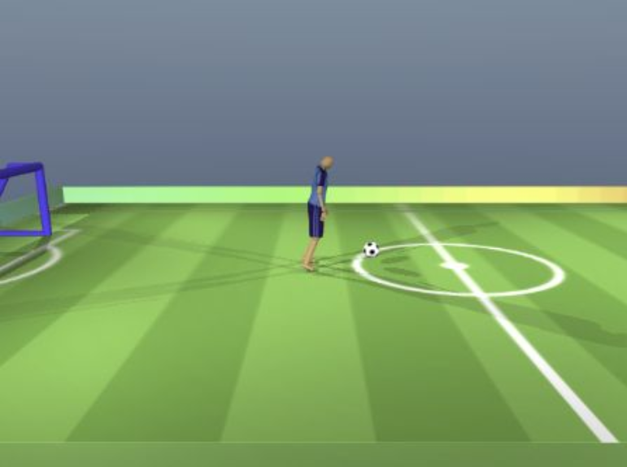
Learning to Score with a Robot Soccer Agent
Jason Dietrich, Leon Manthey, Niklas Rodenbüsch
Julien Brosseit
University of Freiburg
https://github.com/NI-R0/NR9
Introduction
TASK:
Implement DeepMind’s Maximum a Posteriori Policy Optimization (MPO) algorithm [1] from scratch
Investigate MPO’s training dynamics on simple continuous environments
Using MPO, train an agent to score a goal in a custom dm_control’s soccer environment [2]
CHALLENGES:
Continuous control with high degree of freedom
Learning stable bipedal locomotion (i.e. „standing“) difficult to learn in and of itself
Kicking the ball requires policy to learn sequence of skills: standing → walking → making controlled contact with ball → kick ball into goal
MPO ALGORITHM:
An off-policy actor-critic reinforcement learning algorithm
Alternates between policy evaluation and a constrained policy improvement step
Updates the policy by maximizing expected return while limiting deviation from the previous policy (KL constraint)
More sample-efficient and stable than on-policy methods such as PPO [3]
MPO Visuaization (e,g, flowchart)
Method
Implementation of MPO - Implement the Maximum a Posteriori Policy Optimization algorithm according to the official paper - Use the actor-critic formulation with alternating policy and value updates - Verify the implementation on standard continuous-control benchmarks (e.g. cartpole swingup)
Curriculum Learning - Train agent on dm_control native tasks to validate correctness - Increase task complexity incrementally by introducing custom environments that require more sophisticated control - Verify if policy can learn intermediate tasks, by progressing from simplified soccer-related environments (e.g. one-joint stick man) to the full humanoid soccer task
Robot Soccer Training - Train the final policy in the DeepMind Control Soccer environment - Evaluate learning through qualitative behavior (video frames) and quantitative metrics (episode returns) - Analyze whether the agent acquires the necessary skills to consistently approach, control, and score with the ball
Quantitative Results
Qualitative Results
Cartpole (Swingup)
Cartpole (Ball Kick)
Stickman (Stand → Walk/Run)
Humanoid (Stand → Walk/Run)
DeepMind Soccer (all tasks combined)
(SHOW LEARNING CURVES [episode reward, critic loss, maybe compare to baseline method for one task], …)
Cartpole (Swingup)
Cartpole (Ball Kick)
Stickman (Stand → Walk/Run)
Humanoid (Stand → Walk/Run)
DeepMind Soccer (all tasks combined)
(ADD VIDEO FRAMES OF EACH TASK EVOLUTION → Also show on laptop though)
References
[1] Abdolmaleki, Abbas, et al. "Maximum a posteriori policy optimisation." arXiv preprint arXiv:1806.06920 (2018).
[2] Tunyasuvunakool, Saran, et al. "dm_control: Software and tasks for continuous control." Software Impacts 6 (2020): 100022.
[3] Schulman, John, et al. "Proximal policy optimization algorithms." arXiv preprint arXiv:1707.06347 (2017).
Acknowledgement: Huge thank you to Julien Brosseit for his support!
Notes:
TODOs:
check images for resolution before printing
If you open source your code (check with supervisor):
Replace url
Replace QR code (top right), use QR Monkey, it’s free and persistent
Add acknowledgments if applicable (e.g. project funding)
Make sure references are correct

